Slide 1
UNIT 1 - INTRODUCTION

Slide 2
Legal Terms and Maxims
Legal terms
Contract - An agreement between two or more parties creating obligations that are enforceable or otherwise recognizable at law .
Offer - A promise to do or refrain from doing some specified thing in the future, conditioned on an act, forbearance, or return promise being given in exchange for the promise or its performance.
Acceptance - An offeree’s assent, either by express act or by implication from conduct, to the terms of an offer in a manner authorized or requested by the offeror, so that a binding contract is formed.

Slide 3
Offeree - A person who may accept an offer.
Offeror - A person who makes on offer.
Consideration - Something (such as an act, a forbearance, or a return promise) bargained for and received by a promisor from a promise

Slide 4
Maxims
Maxims of Law are , simple statements that anyone can employ in the presentation of their case. They are nothing more than guidelines to help in conveying to a Jury the reasons and justification for doing, or not doing, what was done, or not done, by the Plaintiff or the Defendant.
They are arguments which a Jury must judge, in the same way that they must judge all the facts and laws before them. Maxims are not sacrosanct. They are not unarguable.

Slide 5
Ab Absurdo
Latin: an evidentiary suggestion or statutory interpretation that is, or leads to, an absurdity.
Ab Initio
Latin: from the start; from the beginning.
Alibi
A defence to a criminal charge to the effect that the accused was elsewhere than at the scene of the alleged crime.
Modus Operandi
Latin: method of operation.
Pro Se
Latin: on one’s own behalf.

Slide 6
Meaning of Law and Justice
Definition of Law
The system of rules which a particular country or community recognizes as regulating the actions of its members and which it may enforce by the imposition of penalties.

Slide 7
Theories of Law
1) Natural Law Theory - Natural law holds that law and morality are connected. Law is not simply what is enacted in statutes, and if legislation is not moral, then it is not law, and has no authority.
2) Liberalism - Liberalism, seeks to promote as much individual liberty as is compatible with everyone else having the same liberty, the state should not use the criminal law to prevent immoral conduct that does not cause harm or offence to others.
3) Legal Realism - Legal realism is the view that that we should understand the law as it is practiced in the courts, law offices, and police stations, rather than as it is set forth in statutes or learned treatises.

Slide 8
Meaning of Justice
According to Salmond, “Justice means provide everyone his share”
According to Plato, ‘Justice is a quality. In simple words the meaning of justice is to discharge one’s duties honestly and not to interfere in other actions.
So justice is concerned with human welfare.

Slide 9
aa
Various Dimensions of Justice
1) Legal Dimension of Justice - Justice and laws have close affinity with each other. State makes laws and implements them in order to establish justice in the society.
2) Political Dimensions of Justice - Nobody should be denied of political rights and to provide equal political rights is political justice.
3) Social Dimensions of Justice - Social justice means to give proper opportunities to every citizen, in every sphere of life, to develop his personality and to end all types of social inequalities.
4) Economic Dimensions of Justice - By economic justice mean to provide equal opportunities to everybody to earn his livelihood. It also mean to help such people who are not able to work and earn their livelihood. The basic needs of every body such as food, cloth and shelter should be fulfilled and the unequal distribution of wealth needed to be stopped.

Slide 10
Overview of Constitution
What is a Constitution ?
A constitution is a written document that contains a set of rules for a government. It defines the fundamental political principles, and establishing the structure, procedures, powers and duties, of a government. By limiting the government's own reach, most constitutions guarantee certain rights to the people. The term constitution can be applied to any overall law that defines the functioning of a government.

Slide 11
Why do we need Constitution?
To perform following Functions we need Constitution-
The first function of a constitution is to provide a set of basic rules that allow for minimal coordination amongst members of a society.
The second function of a constitution is to specify who has the power to make decisions in a society. It decides how the government will be constituted.
The third function of a constitution is to set some limits on what a government can impose on its citizens. These limits are fundamental in the sense that government may ever trespass them.
The fourth function of a constitution is to enable the government to fulfill the separations of a society and create conditions for a just society.

Slide 12
The Framing of Constitution of India
The Constituent Assembly of India was elected to write the Constitution of India. Following India's independence from Great Britain, its members served as the nation's first Parliament.
This body was formed in 1946 for the purpose of making independent India's constitution. The assembly passed a resolution in 1947 January defining the objectives of the constitution:-
To set up a Union of India comprising British India and the princely states.
To set up a federal form of government with separate state and central governments.
To set up a democracy in which all power is derived from the people:
I) where all people are guaranteed justice, equality and freedom;
II) where minorities, depressed classes and the tribal's rights are protected;
To protect the integrity of India and her sovereign rights over land, sea and air.
To help India attain its rightful place in the world - and work for peace and welfare of all mankind.

Slide 13
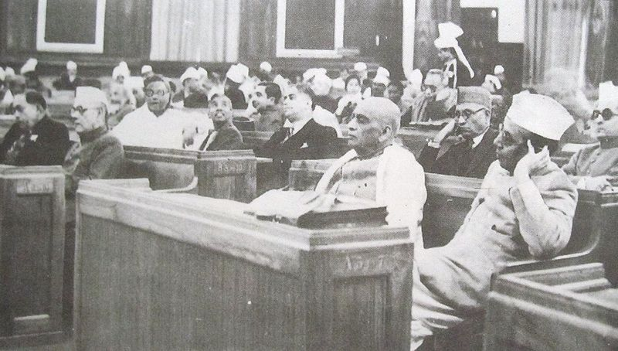
The Constituent Assembly consisted of 385 members, of which 292 were elected by the elected members of the Provincial Legislative Assemblies while 93 members were nominated by the Princely States. To these were to be added a representative each from the four Chief Commissioners Provinces of Delhi, Ajmer- Marwar, Coorg and British Baluchistan.

Slide 14
The Preamble to Constitution of India
The Preamble to the Constitution of India is a brief introductory statement that sets out the guiding purpose and principles of the document.
WE, THE PEOPLE OF INDIA, having solemnly resolved to constitute India into a SOVEREIGN SOCIALIST SECULAR DEMOCRATIC REPUBLIC and to secure to all its citizens: JUSTICE, social, economic and political; LIBERTY of thought, expression, belief, faith and worship; EQUALITY of status and of opportunity; and to promote among them all FRATERNITY assuring the dignity of the individual and the unity and integrity of the Nation; IN OUR CONSTITUENT ASSEMBLY this twenty-sixth day of November, 1949, do HEREBY ADOPT, ENACT AND GIVE TO OURSELVES THIS CONSTITUTION.

Slide 15
The Basic Principles of the Constitution of India
A careful study of the Constitution will show that there are at least eight basic principles which are embodied in it and which form the foundation of the political system in India. These are:
(1) Popular sovereignty,
(2) Socialism,
(3) Secularism,
(4) Fundamental rights,
(5) Directive Principles of State Policy,
(6) Judicial independence,
(7) Federalism and
(8) Cabinet government.

Slide 16
Main Characteristics of the Constitution of India
The Constitution of India has some distinct and unique features as compared to other constitutions to the world. As Dr. B.R. Ambedkar, the Chairman of the Drafting Committee puts it, the framers had tried to accumulate and accommodate the best features of other constitutions, keeping in view the peculiar problems and needs of our country. Main Characteristics of Constitution of India are:-
Longest written constitution.
Partly Rigid and Partly Flexible
A Democratic Republic
Parliamentary System of Government
A Federation
Fundamental Rights
Directive Principles of State Policy
Fundamental Duties
Secular State
An Independent Judiciary
Single Citizenship

Slide 17
Hierarchy of Courts
Administration of Justice
Most essential function of the State.
Power exercised by the State through judiciary to enforce rights and punish wrongs.
It involves two parties
- Plaintiff and Defendant – in civil cases
- Complainant and Accused or
- Prosecution and Accused – in criminal cases

Slide 18
Judicial Process involves
- A right claimed or a wrong complained by one party against the other.
- Hearing of the parties by the Court.
- Judgment of the Court delivered at the end of the trial.
- Execution of the operative part of the judgment.

Slide 19
System of Courts in India
At National level – Supreme Court of India
At State level – High Court
At District and Subordinate level – Subordinate Courts (Civil and Criminal)

Slide 20
Supreme Court
In Indian legal system hierarchy, the Supreme Court is at the top level of the Indian court system. The Supreme Court is the utmost authority holder court system in India whose decision can’t be challenged by any other Indian court. If someone wishes to challenge it, he/she has to file a letter to President or Prime Minister of India to do so.
Indian legal system has only one Supreme Court and that is in Delhi, the national capital of India. The Supreme Court came into existence in the year 1950 on 28th of January; soon 2 days after the constitution of India came into continuation. Ever since that time, this highest court has been in Delhi.

Slide 21
Jurisdiction of the Supreme Court
Court of Record. Has power to punish for contempt. (A.129)
Original Jurisdiction. (A.131)
Highest Court of Appeal in the country. (A.132,133,134 & 136)
Writ jurisdiction.(A.32)
Advisory Jurisdiction.(A.143)
Law declared by the Supreme Court binding on all Courts in India.(A.141)

Slide 22
Jurisdiction of the High Court
Court of Record. Has power to punish for contempt. (A.215)
Original Jurisdiction in civil and criminal matters in the case of some High Courts.
Appellate jurisdiction in respect of criminal and civil cases decided by Subordinate courts.
Revisional Jurisdiction conferred under the Civil Procedure Code and Criminal Procedure Code.
Writ jurisdiction.(A.226)
Administrative Jurisdiction over subordinate courts.

Slide 23
District Courts
Every state of India further incorporates some lower courts that are lower in terms of power and authority than the High Court of that state. These courts are in terms of district means every district of a state has a court that employs maximum government judicial power in that district only. The district court is further sub categorized into 3 parts as below –
Session Courts – These are a part of District Court with high power. These employ maximum power in a district.
Lower Courts – These are the lower level courts and most of the times, all the cases of nearby areas are sent to these courts.

Slide 24
Various tribunals and Appellate Boards
The Indian Judicial System also consists of many Tribunals and Appellate Boards constituted for a specific purpose. The power, jurisdiction and procedure of these forums is generally governed by the Statutes constituting them. Intellectual Property Appellate Board (IPAB) is one of the most prominent among these forums and it enjoys appellate as well as original jurisdiction in IP matters.

Slide 25
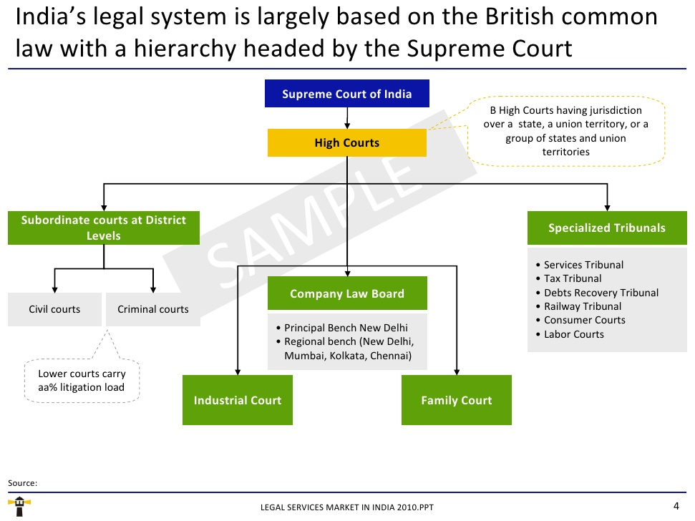

Slide 26
Alternative Dispute Resolution in India
ADR or “Alternative Dispute Resolution” is an attempt to devise machinery which should be capable of providing an alternative to the conventional methods of resolving disputes. ADR offers to resolve matters of litigants, whether in business causes or otherwise, who are not able to start any process of negotiation and reach any settlement. It has started gaining ground as against litigation and arbitration.

Slide 27
Law Making Process
The Indian constitution gives the law making procedure in Indian Parliament. The primary function of the Indian Parliament is to make, fresh laws and to revise or abrogate existing laws.
Bills passed by the Parliament falls into two categories:
(a) money bills and
(b) non-money or, ordinary or, public bills.
The procedures prescribed by the constitution for passing the two categories of bills are different.

Slide 28
Procedure of passing ordinary or public bills-An ordinary bill has to pass through different stages before becoming an Act. An ordinary bill may be introduced in either House of the Parliament.
The first stage is the introduction or the firstly reading of the bill. Most such bills are introduced by ministers. They are drafted by technical experts and approved by the Council of Ministers. Ordinary members of the Parliament may also introduce bills. One month’s notice has to be given to the speaker or, the chairman of the Rajya Sabha before the introduction of the bill. Then on a date fixed by the speaker or the chairman, the mover rises on his seat to move the bill. This is the introduction or the first reading of the bill which is a formal affair. No debate usually takes place at this stage. But on an unusual bill, for example the bill on Preventive Detention in 1954 may be opposed by the opposition at its very introduction. After introduction, the bill is published in the Gazette of India. The speaker or, the chairman may allow some bills to be gazette even before the first reading. Such bills do not require formal introduction in the Parliament.

Slide 29
The next stage in the life of a bill is the Second Reading which usually takes place after an interval of two days after the first reading. At this stage, any of the four courses are adopted.
The bill may be taken for consideration by the House at once.
It may be sent to a select committee of the House.
It may be sent to a joint select committee of the two Houses and
It may be circulated for eliciting public opinion. Very rarely bills are taken up for consideration straight way.

Slide 30
Committee Stage
If the bill is referred to a select committee, the mover selects the members of the committee, the Speaker or the Chairman appoints one member of the committee, the chairman of the committee. The committee makes a careful study of the bill and reports back to the House.

Slide 31
Report Stage
The original bill along with the report of the Select committee is circulated among the members. It is at this stage that the bill is debated clause by clause. At two stages in the career of a bill debates take place. In the Second Reading, when the bill is debated in principle and at the report stage, when it is debated clause by clause. The Second Reading is most crucial in the life of the bill while the Report stage is most important as giving final shape to the bill. After the bill is passed by a majority vote, it is submitted for the Third Reading.
The Third Reading like the First Reading is only formal. No debate takes place and no bill is rejected at this stage.

Slide 32
After the bill is adopted at the Third Reading, it’s transmitted to the other House where it goes through all the stages as in the originating House. The other House may accept the bill. In that case it is sent to the President for his assent. The other House also may reject the bill or, may introduce amendments not acceptable to the original House or, may not return the bill within six months. In any of such case, a constitutional deadlock develops between the two Houses. The President may call a joint session of the two Houses to resolve the deadlock. The Speaker or in his absence the Deputy Speaker presides over such joint sessions. The deadlock is dissolved by majority vote.
Finally the bill passed by both Houses goes to the President for his assent. If the President assents to the bill, it becomes a law. The President may return the bill for reconsideration. If the bill is sent back to the President with or, without amendments, the President cannot withhold his assent. This complicated and time consuming procedure is adopted to prevent hasty legislation.
When the 4th course is adopted, the secretariat of the House concerned request the State Governments to publish the bill in the State Gazettes inviting opinions from local bodies and recognized associations. Such opinions are circulated among the members of the House.

Slide 33
Role of Executive, Judiciary and Legislature
Political theory envisages a Separation of Powers between the three main organs of government i.e. the legislature, the executive and the judiciary, in the interest of prevention of concentration of power. In India we have a somewhat diluted Separation of Powers, with an efficient system of checks and balances to ensure the prevention of abuses of power in the hands of any organ of government.

Slide 34
The Executive
The Prime Minister is the leader of the Central Executive branch of the Government of India. He or she, along with his Council of Ministers, also appointed by the President, is responsible for the day-to-day functioning of the Government. It must be noted that though the President ceremonially appoints the Prime Minister and the Council of Ministers, in actual practice, the Prime Minister is appointed in mutual consultation with the party claiming the winning majority in the Lok Sabha. The President, then, with the Prime Minister, in mutual consultation, appoints the Council of Ministers.
Thus, the Majority party or alliance in the Lok Sabha selects its leader and proposes his/her name to the President for him to appoint.
The Prime Minister is the senior most member of the cabinet and also nominates the rest of the members who are appointed by the President.

Slide 35
The Legislature
The Legislature consists of two houses that constitute the Parliament, i.e. a bi-cameral form of legislature.
The country is split up into separate geographical areas, known as constituencies from where parliamentarians are elected. There are two types of constituencies: Assembly constituencies and Parliamentary constituencies.
Parliamentary Constituency: An area that returns a Member of Parliament (MP) to the Lok Sabha (Lower House of Union Parliament).
Assembly Constituency: An area that returns a Member of Legislative Assembly (MLA) to the Vidhan Sabha (Lower House of the State Legislature).

Slide 36
Union Legislature:
Lok Sabha
The Lower House of Union Parliament, also known as the Lok Sabha is the House of the People. The members of the Lok Sabha are directly elected by the people of India
The Lok Sabha is formed for a term of five years, unless dissolved by the President.
The Prime Minister is elected from the party with majority in the Lok Sabha.

Slide 37
Rajya Sabha
The Upper House of Union Parliament, or the Rajya Sabha, is the Council of States. While the Lok Sabha pffers representation to the people, the Rajya Sabha offers representation to the various State Governments of our Federal Union. The members of the Rajya Sabha are not directly elected by the people as practiced in the Lok Sabha.
The members of the Legislative Assemblies (MLAs) of states and Union Territories elect the candidates of the Rajya Sabha.
Though the members of the Lok Sabha are directly elected by the citizens of India, the members of Rajya Sabha are elected by State Legislatures.
There are 238 members that are elected into the Rajya Sabha.

Slide 38
State Legislature:
The State Legislature in India varies from state to state. It is unicameral – i.e. only The House of the People exists – in all but six states in the Union. The six states are Andhra Pradesh, Bihar, Jammu-Kashmir, Karnataka, Maharashtra and Uttar Pradesh where bicameral State Legislatures exist – i.e. they consist of the Legislative Council and the Legislative Assembly.
The idea of a bicameral legislature in these six states is to obtain a second opinion on all matters of legislation, and this is important, given the size and population of these states. Vidhan Sabha (Legislative Assembly)
It is also known as the Legislative Assembly. It is similar to the Lok Sabha at the Centre, and is directly elected by the people of the state.

Slide 39
Judiciary
The Supreme Court
The Supreme Court of India is the highest authority in the judicial hierarchy, and contains the original advisory judicial system of the country. The Supreme Court is responsible for enforcing fundamental rights to the citizens of India.
The main functioning of the SC is to deal with cases related to conflict between the Central and State governments or that of between two states. It also looks into cases that have come up via the appeal of the High Court.

Slide 40
It is headed by the Chief Justice of India, who is appointed by the President, and consists of 25 other judges who are also appointed by the President, consulating with the Chief Justice. All of them can hold their position till 65 years of age.

Slide 41
The High Courts
The High Court stands at the head of a State’s judicial administration. Primarily, work of most High Courts consists of appeals from lower courts. There are 18 High Courts in the country, three having jurisdiction over more than one State. Among the Union Territories Delhi alone has a High Court of its own. Other six Union Territories come under the jurisdiction of different State High Courts.
Each High Court comprises a Chief Justice and such other Judges as the President may appoint.
The Chief Justice of a High Court is appointed by the President in consultation with the Chief Justice of India and the Governor of the State.

Slide 42
District Courts
Last in the hierarchy of the judicial system are District Courts. They are under the judicial and administrative control of the High Court of their respective states.
The presiding judge over a District Court is a District Judge, and he is supported by Assistant District Judges and Additional District Judges.
There are different courts for different cases, for example:
Civil Cases: Court of Civil Judge
Criminal Cases: Court of Judicial Magistrate
Small-Scale Financial Hazards: Junior Division Civil Judge
There are a total of 600 District Courts in India. Depending on the size of the state, a given number of District Courts are allocated. Uttar Pradesh has 70 District Courts, while Goa has only

Slide 43
Systems of Law
Common Law System
Countries following a common law system are typically those that were former British colonies or protectorates, including the United States.
Features of a common law system include:
There is not always a written constitution or codified laws;
Judicial decisions are binding – decisions of the highest court can generally only be overturned by that same court or through legislation;
Extensive freedom of contract - few provisions are implied into the contract by law (although provisions seeking to protect private consumers may be implied);
Generally, everything is permitted that is not expressly prohibited by law.

Slide 44
Civil Law System
Countries following a civil law system are typically those that were former French, Dutch, German, Spanish or Portuguese colonies or protectorates, including much of Central and South America. Most of the Central and Eastern European and East Asian countries also follow a civil law structure.
The civil law system is a codified system of law. It takes its origins from Roman law. Features of a civil law system include:
There is generally a written constitution based on specific codes (e.g., civil code, codes covering corporate law, administrative law, tax law and constitutional law)

Slide 45
enshrining basic rights and duties; administrative law is however usually less codified and administrative court judges tend to behave more like common law judges;
Only legislative enactments are considered binding for all. There is little scope for judge-made law in civil, criminal and commercial courts, although in practice judges tend to follow previous judicial decisions; constitutional and administrative courts can nullify laws and regulations and their decisions in such cases are binding for all.
In some civil law systems, e.g., Germany, writings of legal scholars have significant influence on the courts;
Courts specific to the underlying codes – there are therefore usually separate constitutional court, administrative court and civil court systems that opine on consistency of legislation and administrative acts with and interpret that specific code;
Less freedom of contract - many provisions are implied into a contract by law and parties cannot contract out of certain provisions.

Slide 46
Procedural and Substantive Law
Procedural law consists of the set of rules that govern the proceedings of the court in criminal lawsuits as well as civil and administrative proceedings. The court needs to conform to the standards setup by procedural law, while during the proceedings. These rules ensure fair practice and consistency in the "due process".
Substantive law is a statutory law that deals with the legal relationship between people or the people and the state. Therefore, substantive law defines the rights and duties of the people, but procedural law lays down the rules with the help of which they are enforced.

Slide 47
Powers of Substantive vs. Procedural Laws
Substantive law is an independent set of laws that decide the fate of a case. It can actually decide the fate of the under-trial, whether he wins or loses and even the compensation amounts etc. Procedural laws on the other hand, have no independent existence. Therefore, procedural laws only tell us how the legal process is to be executed, whereas substantive laws have the power to offer legal solution.
Differences in Application
Another important difference lies in the applications of the two. Procedural laws are applicable in non legal contexts, whereas substantive laws are not. So, basically the essential substance of a trial is underlined by substantive law, whereas procedural law chalks out the steps to get there.

Slide 48
Business and Human Rights Violation
Companies have joined together, in some cases with governments, international organizations and/or NGOs, in voluntary initiatives to address some human rights issues. An increasing number of companies are taking positive steps to promote human rights. Companies have long been accused of responsibility for human rights abuses.
Examples:
Illegal gold mining has left at least 2,000 children suffering from lead poisoning in several villages in Zamfara State of Nigeria, where more than 400 children have already died from contamination...Lead has been dispersed in the villages by the processing of ore for gold extraction...Most of the victims are from Bagega village, a 9,000-strong farming and herding community where all 1,500 children suffer from lead poisoning.

Slide 49
Characteristics of Human Rights:
The main characteristic features of human rights may be analyzed in the following manner:
1. Human rights imply that everyone should have them. People do not enjoy them as the member of a particular nation or of a community, rather as the member of the human society. So human rights are universally applicable to all without any discrimination on the grounds of caste, class, color, sex, religion etc.
2. Human rights, as a comprehensive whole, include socio­economic, civil, political, cultural rights which are deemed to be essential for the human beings to lead a life of dignity.
3. Human rights are justiciable. They cover legal rights protected by the law of the state. They also cover fundamental rights as incorporated in the constitution of the land and they enjoy judicial enforcement.
4. Human rights are not absolute. Like all rights, they may also be restricted in the interest of public peace, social decency, political security and the like.

Slide 50
5. Human beings cannot stay without the enjoyment of human rights. All of them possess these rights as the members of the human society. Since some people are ignorant of these rights, they must be taught about these opportunities. They only can lead a life of peace, security and dignity with the growing consciousness of these rights.

Slide 51
Types of Human Rights
Social or Civil Human Rights
Political Human Rights
Economic Human Rights
Cultural Human Rights

Slide 52
Labour Laws
Definition- Body of rulings pertaining to working people and their organizations, including trade unions and employee unions, enforced by government agencies. There are two categories of labor laws; collective and individual. Collective labor law involves relationships between the union, the employer and the employee. Individual labor law involves concerns for employees' rights in the workplace. Labor laws first became standard during the Industrial Revolution. Also called employment law.

Slide 53
Indian Labour Laws
Indian labour law refers to laws regulating labour in India.Traditionally, Indian governments at federal and state level have sought to ensure a high degree of protection for workers, but in practice, legislative rights only cover a minority of workers. India is a federal form of government and because labour is a subject in the concurrent list of the Indian Constitution, labour matters are in the jurisdiction of both central and state governments; both central and state governments have enacted laws on labour relations and employment issues.
Indian Factories Act, 1948
The Minimum Wages Act, 1948
The Payment of Wages Act, 1936
The Payment of Bonus Act, 1965
The Payment of Gratuity Act, 1972
Workmen Compensation Act, 1923

Slide 54
The Employees State Insurance Act, 1948
The Employee Provident Fund and Miscellaneous Provision Act, 1952
Industrial Disputs Act, 1947
Equal Remuneration Act, 1976
Contract Labour (Regulation and Abolition) Act, 1970
The Trade Union Act, 1926
The Maternity Benefits Act, 1961

Slide 55
Theories of Law
1) Natural Law Theory - Natural law holds that law and morality are connected. Law is not simply what is enacted in statutes, and if legislation is not moral, then it is not law, and has no authority.
2) Positivism - Positivism emphasizes the separation of law and morality. According to legal positivists, law is man-made, or “posited,” by the legislature. Where natural law theorists may say that if a law is not moral there is no obligation to obey it, by appealing to moral or religious principles, but positivists hold that until a duly enacted law is changed, it remains law, and should be obeyed.
3) Legal Realism - Legal realism is the view that that we should understand the law as it is practiced in the courts, law offices, and police stations, rather than as it is set forth in statutes or learned treatises.

Slide 56
4) Liberalism - Liberalism, seeks to promote as much individual liberty as is compatible with everyone else having the same liberty, the state should not use the criminal law to prevent immoral conduct that does not cause harm or offence to others.
5) Utilitarianism - Bentham argued that a utilitarian view of the law is that the law should produce the best consequences. The utilitarian approach is most often seen the relation between law and economics where the law supports the creation of wealth.
6) Plato - Plato argued that man is naturally good and simply needs education to guide his behaviour, while Marx saw law as a tool of class oppression that we could be do away with, once a truly socialist society had taken over.
7) Marxism - Marx saw the law as an instrument of control by capital of the working classes. Sometimes law appears to work in their favour but in reality only serving capital. Property laws in the UK serve well those that are landed and have goods and chattels

Slide 57
THANK YOU

